Slide 1

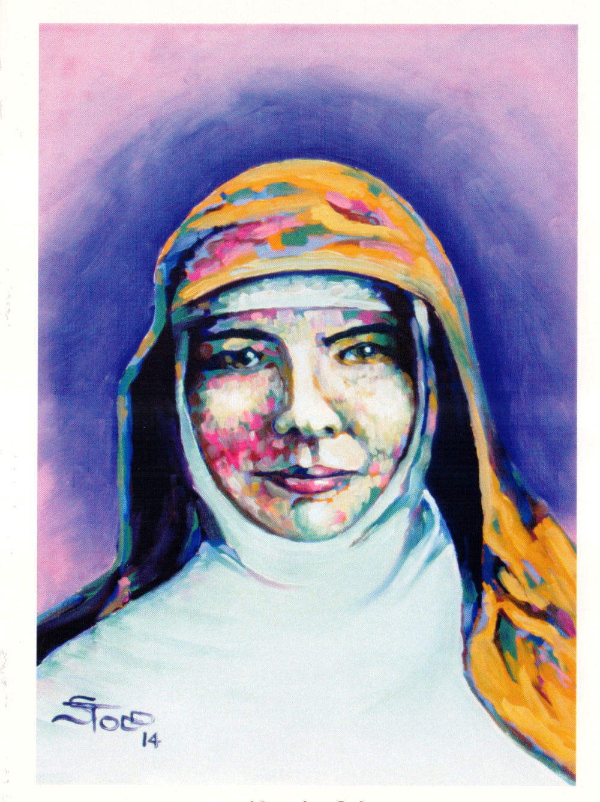


Be Fierce for Fair
Mary MacKillop’s Feast day
8th August.
1
Notes:
2

Slide 2
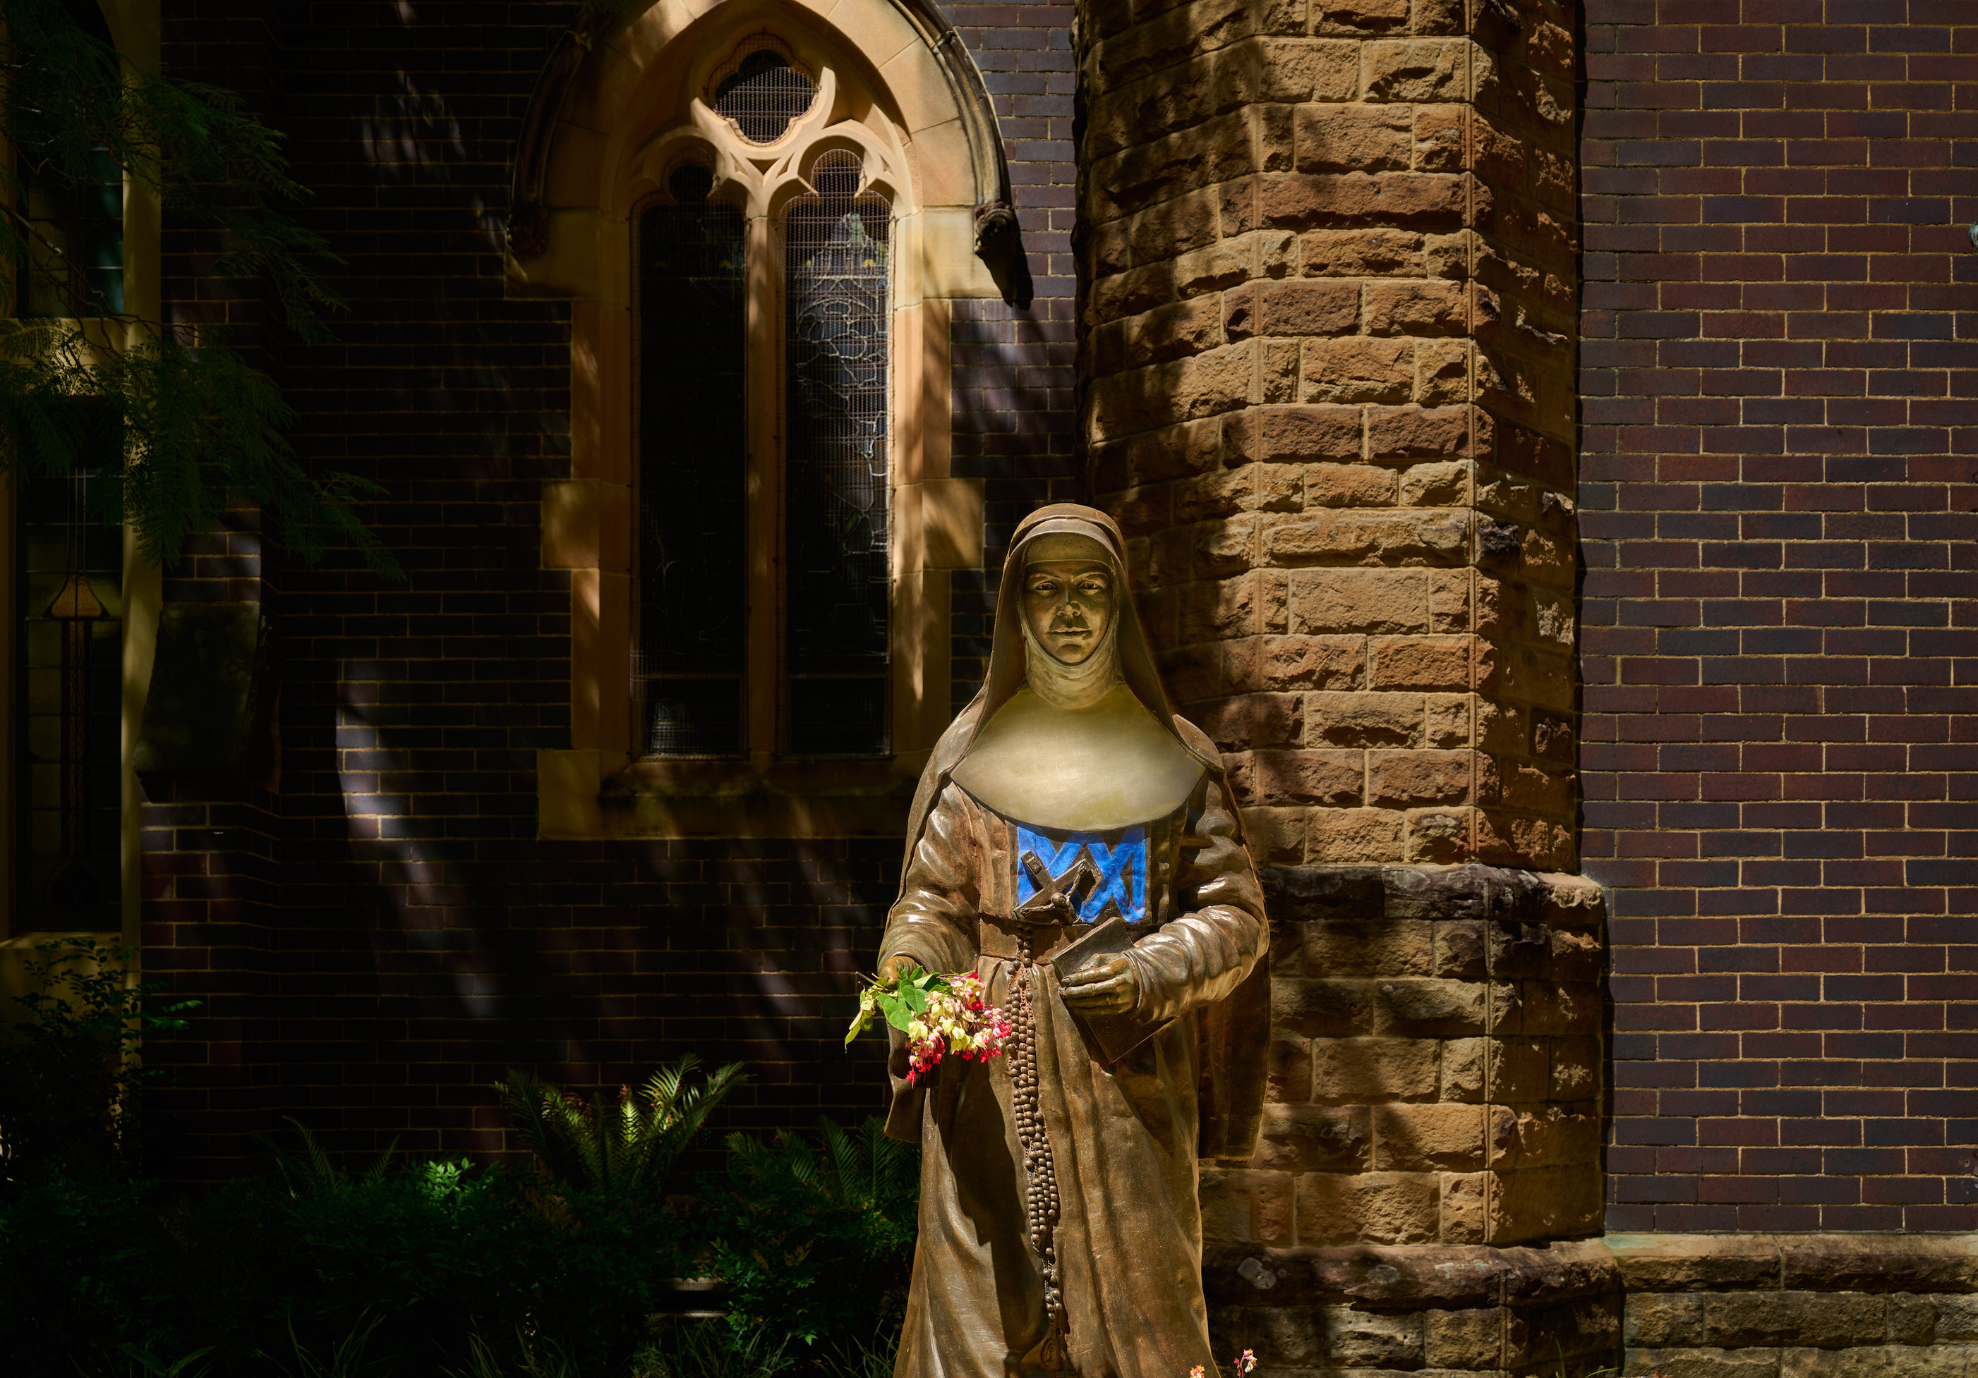

Mary MacKillop Today walks alongside communities experiencing injustice and poverty to create lasting change. Inspired by the courage of Australia’s first Saint, we turn hope into action through education, financial inclusion and life skills that strengthen dignity and self-determination.
Together, we help build futures shaped by opportunity, not circumstance.
‹#›
2

Slide 3
Be Fierce for Fair
WHO IS MARY MACKILLOP
  Mary MacKillop is Australia’s first and only Saint.
  She was born in Victoria in 1842 and had 8 brothers and sisters.
  Mary became a Saint because she devoted her life to God and serving other people.
  Mary and Father Julian Tenison Woods started the Sisters of St Joseph.
  They opened schools all over Australia so children across the country could receive an education.
  Mary faced many challenges throughout her life but always looked after others, especially vulnerable communities.
3

Slide 4
Be Fierce for Fair
WHAT IS FEAST DAY?
  All Saints have a Feast Day to remember and pray with them.
  Mary MacKillop’s Feast Day is on 8ᵗʰ August, which is the day she died.
WHAT DOES IT MEAN TO BE A SAINT?
  Saints were once people just like us.
  People who become Saints have devoted their life to God and serving others.
  Canonisation is when the Pope declares the person a Saint at a very special ceremony in Rome.
4

Slide 5
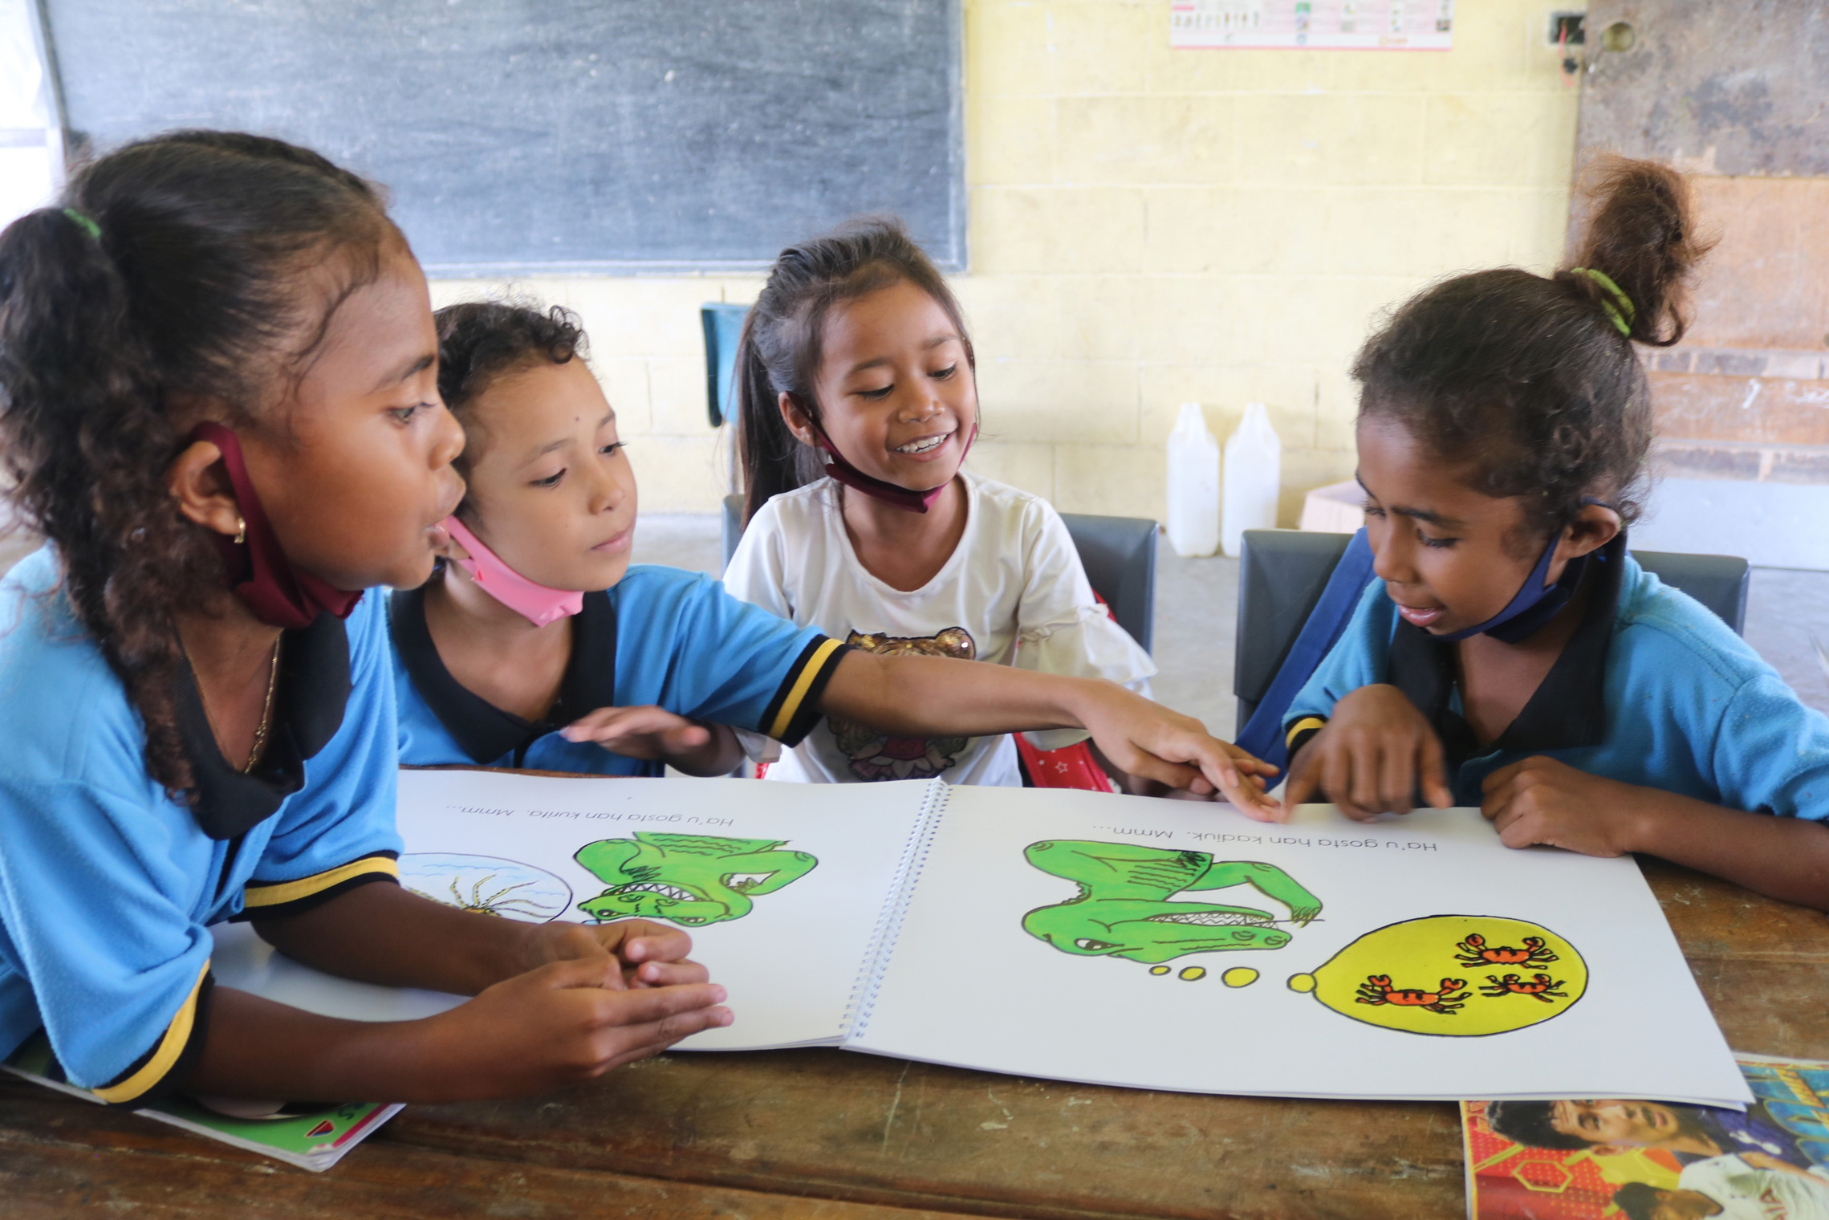

Be Fierce for Fair
WHO IS MARY MACKILLOP TODAY?
Mary MacKillop Today is a not-for-profit organisation that continues the work of Mary MacKillop and the Sisters of St Joseph by delivering programs in Australia and overseas that focus on education, health, financial support and livelihoods.
5

Slide 6

Be Fierce for Fair - learn more at marymackilloptoday.org.au
WHAT DOES MARY MACKILLOP TODAY DO?
  Advocates for fair access to education
  Works with communities to create lasting change
Timor Leste
PROJECTS
  Inclusive Early Education
  Health Literacy
  EdTech
  Volunteer Teacher Support
Fiji
PROJECTS
  Community training and social work
  Empowering Persons with Psychosocial Disabilities: a pathway to economic independence
Peru
PROJECTS
  Student Leaders for Active Environmental Citizenship
  Enhancing Women’s Civil Participation
Australia
PROJECTS
  No Interest Loan scheme
  Financial Counselling
  Financial Literacy
  First Nations tertiary Scholarships Program
  Community Grants Programs
  Equine Assisted Learning
6

Slide 7
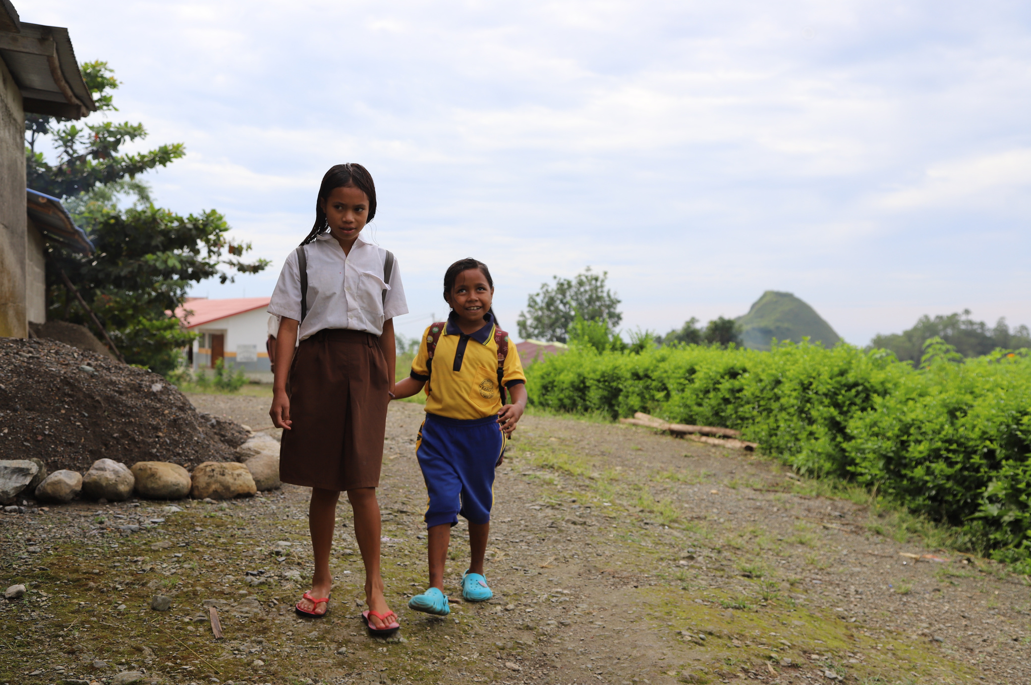
Be Fierce for Fair
THE NEED IN TIMOR-LESTE
  Many people in Timor-Leste live in poverty without access to education.
  Schools don’t have many resources.
  Many teachers have had limited education themselves, and some work as volunteers.
STUDENTS LIKE MARIA
Nine years old and living with a visual disability, she makes the long walk to school every day, guided by others along narrow paths and across rivers, because she loves to learn and refuses to be left behind. Her father Silveiro, who is also her teacher, says she comes home from school and asks whether she should eat first or study first. Maria is now in Grade 3, grasping ideas quickly and meeting every challenge with determination.
7

Slide 8
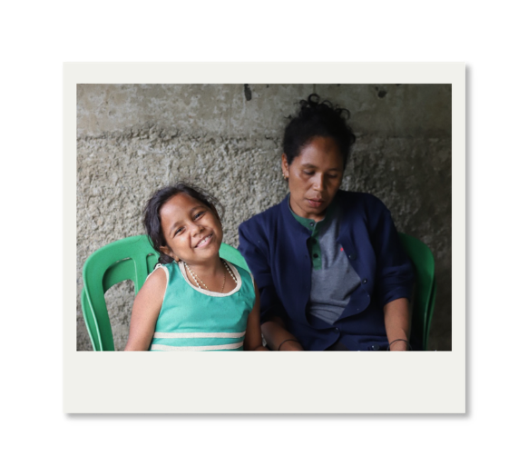
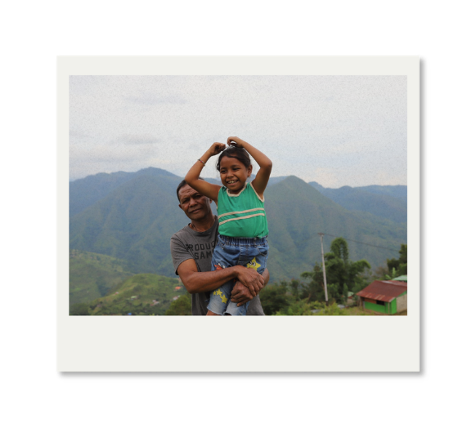
Be Fierce for Fair
STUDENTS LIKE MARIA
Children like Maria are at the heart of the Mary MacKillop Today Inclusive Early Education Program. The program works with teachers and communities to create welcoming classrooms where every child can participate, learn and belong. It equips teachers with training and creative tools — including books, puppets, arts and crafts, and musical instruments — to help them teach in more inclusive and interactive ways. Local educators also work with families to build the confidence and skills to support children's learning at home.
8

Slide 9
Be Fierce for Fair
THIS AUGUST, LET’S BE FIERCE FOR FAIR AND FOLLOW THE EXAMPLE OF AUSTRALIA’S MOST LOVED SAINT AND STAND UP TO INJUSTICE WHEN WE SEE IT.
9

Slide 10
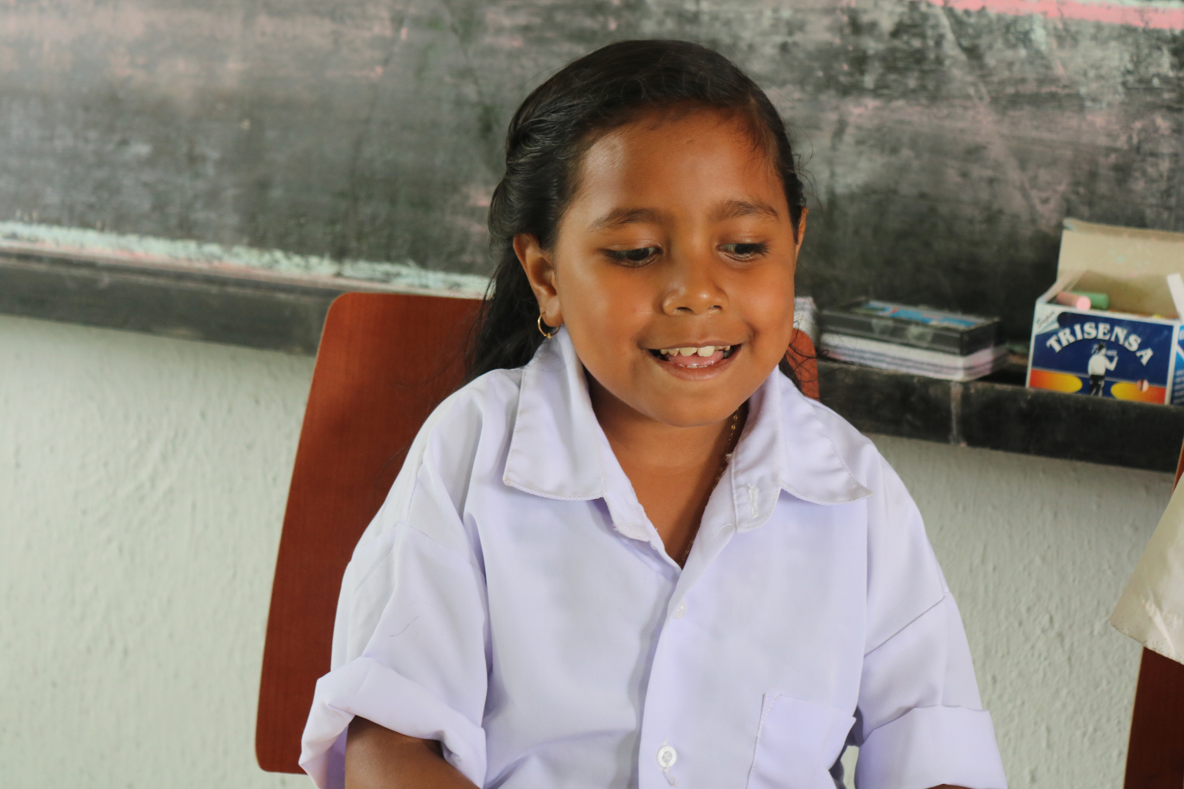

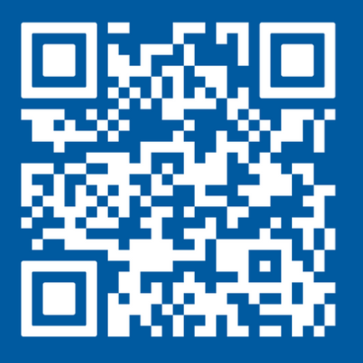
Thank you!
FIND OUT MORE ABOUT THE WORK OF MARY MACKILLOP TODAY AT
WWW.MARYMACKILLOPTODAY.ORG.AU
SCAN ME
10
Notes:
18

Slide 11
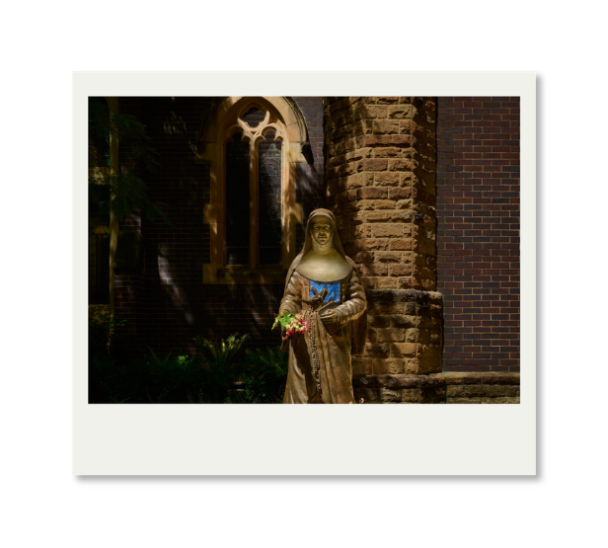
Be Fierce for Fair
At Mary MacKillop Today, we forge paths where others hesitate to tread. Guided by the trailblazing spirit of Australia’s first Saint, we are driven to go where the need is greatest and to stand in solidarity with people pushed to the margins.
WE HONOUr a legacy that teaches us to never see a need without doing something about it. We believe that hope is not a passive sentiment. It comes alive with pragmatic, loving action. And it is hope that creates practical possibility; seeing what can be done and then doing it.
Through vital programs in education, financial inclusion and life skills, we work in strengths-based partnerships with communities to unlock self-determination and protect dignity. We do this in genuine partnership, guided by the voices and priorities of the communities we walk alongside, so our impact is meaningful and enduring.
We continue in Saint Mary MacKillop’s footsteps to turn possibility into reality, understanding that education is the spark that unlocks dignity and fuels equity.
From the classroom to the community, we are building a future where every person can rise with courage.
11

Slide 12

Cammeraygal Country
Level 5, 12 Mount St, North Sydney 2060
ACN 159 091 737 | ABN 88 808 531 480
02 8912 2777
hello@marymackilloptoday.org.au
www.marymackilloptoday.org.au
Cammeraygal Country
Level 5, 12 Mount St, North Sydney 2060
ACN 159 091 737 | ABN 88 808 531 480
02 8912 2777
hello@marymackilloptoday.org.au
www.marymackilloptoday.org.au

