Slide 1
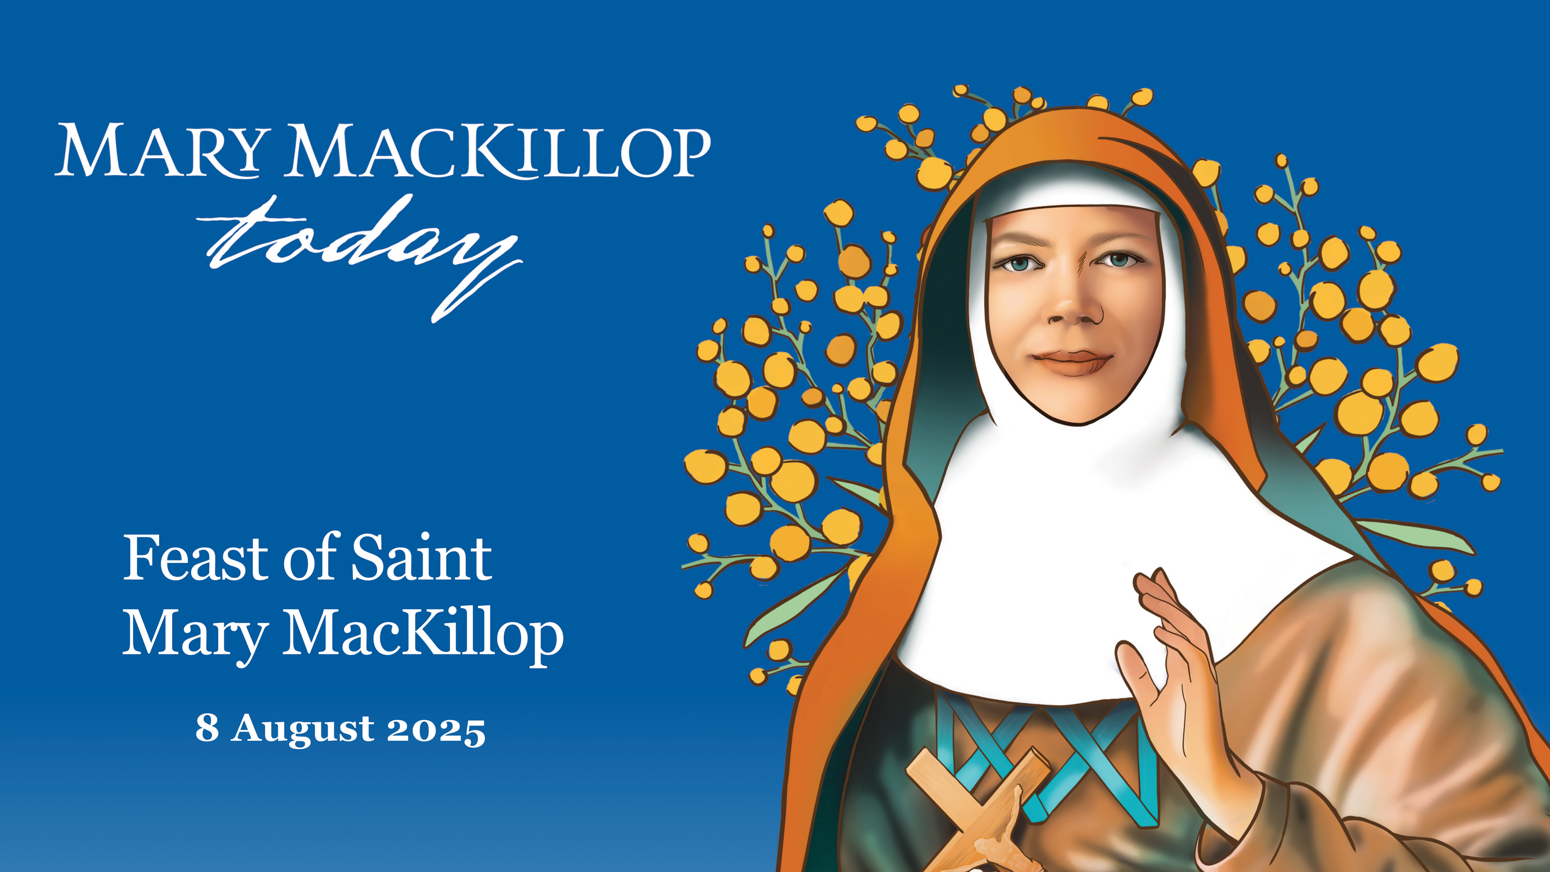
Notes:
A note to presenter:
We hope this PowerPoint is a useful resource for you to introduce Mary MacKillop's Feast Day to your audience. We have included basic explanations on each slide, and more detailed explanations in the slide notes.
1

Slide 2
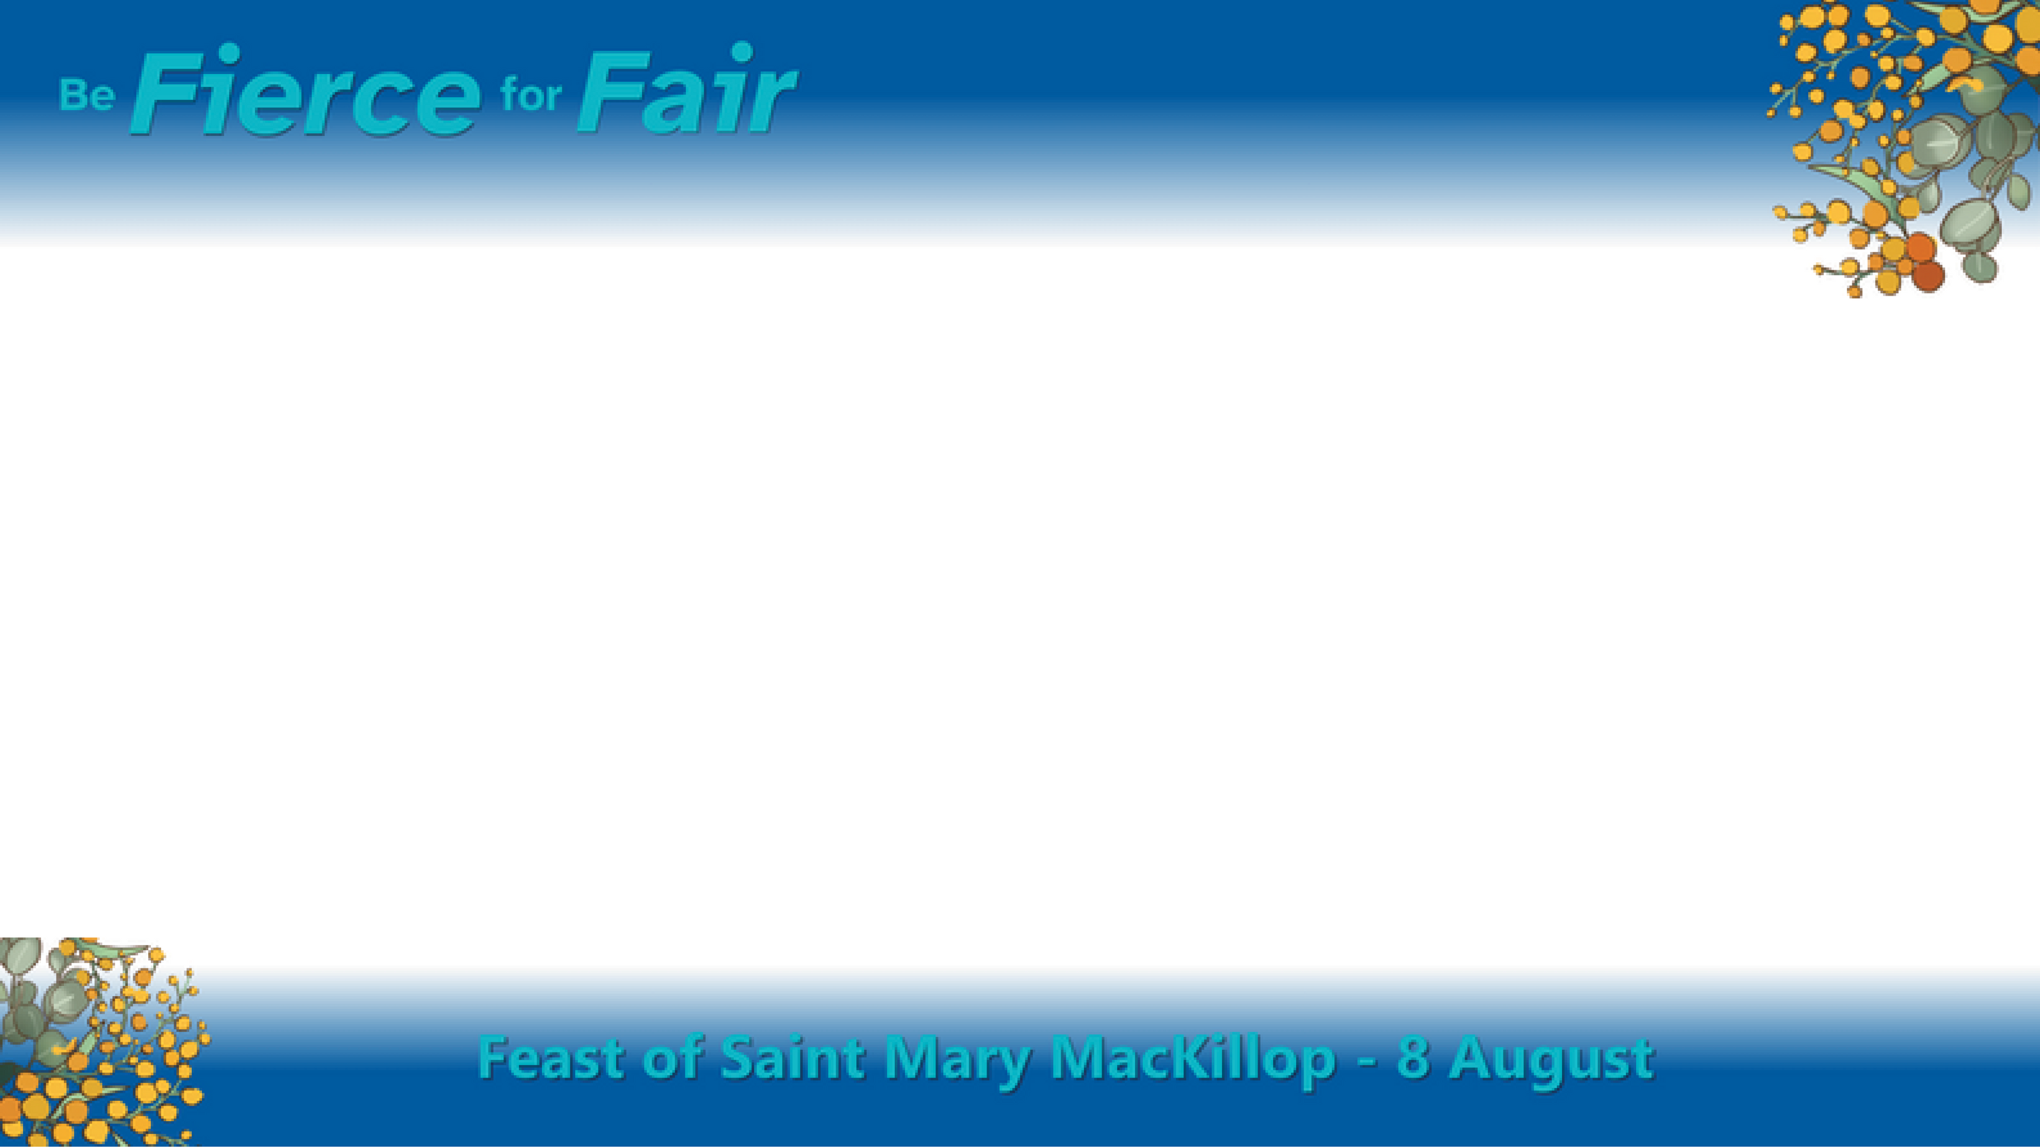
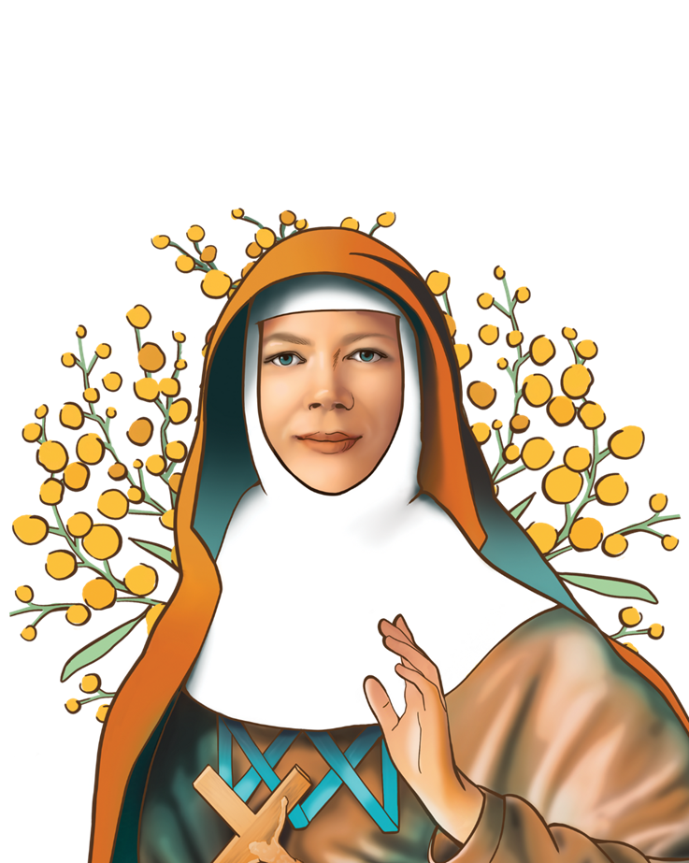
Who is Mary MacKillop?
  Mary MacKillop is Australia’s first and only Saint.
  She was born in Victoria in 1842 and had 8 brothers and sisters.
  Mary became a Saint because she devoted her life to God and serving other people.
Notes:
Mary Helen MacKillop was born in 1842 in Victoria to Scottish immigrant parents and grew up with seven brothers and sisters.
At the age of twenty-four, she dedicated her life to God and took on the name “Mary of the Cross.”
Mary was an ordinary woman with an extraordinary dream and a big heart. Her dream was to give the poorest families and most neglected children access to education and safe shelter by opening schools.
2

Slide 3
Who is Mary MacKillop?
  Mary and Father Julian Tenison Woods started the Sisters of St Joseph.
  They opened schools all over Australia so children across the country could receive an education.
  Mary faced many challenges throughout her life but always looked after others, especially vulnerable communities.
Notes:
With what little resources they had, Mary and Father Tenison Woods turned an old stable into a school in Penola, South Australia.
In 1866 Mary and Father Tenison worked together to set up the Sisters of St Joseph of the Sacred Heart (the Josephites). This was the first religious order to be founded by an Australian.
As a passionate educator, Mary broke through the prejudice of the early 19th century to educate all—regardless of gender, race, faith, or wealth—while ministering to the vulnerable with compassion.
She and the Sisters of St Joseph went wherever the need was greatest. They gave up everything to live and teach amongst the people they served.

Slide 4
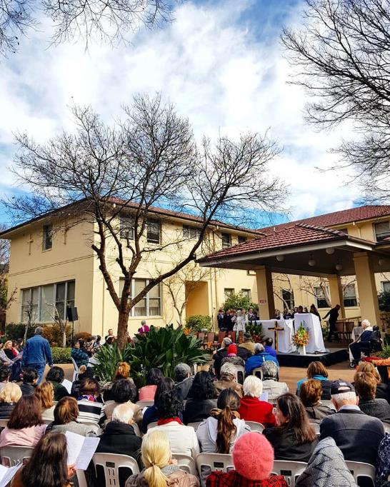
What is a Feast Day?
  All Saints have a Feast Day to remember and pray with them.
  Mary MacKillop’s Feast Day is on 8ᵗʰ August, which is the day she died.
Feast Day 2018, Mary MacKillop Place, North Sydney
Notes:
All Saints have dedicated Feast Days when they are remembered with special mention and prayers. Mary MacKillop’s Feast Day is on 8th August, which is the day she died.
Mary’s Feast Day is a wonderful time to reflect on the qualities and actions that set her apart, and how her legacy continues to be relevant today.
Mary MacKillop fiercely believed in the power of education to lift communities out of poverty.
Education in Australia is what it is today, thanks in large part to the dedication and determination of Mary and the Sisters of St Joseph.
4

Slide 5
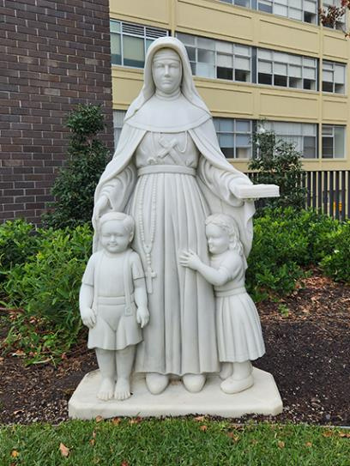
What does it mean to be a Saint?
  Saints were once people just like us.
  People who become Saints have devoted their life to God and serving others.
  Canonisation is when the Pope declares the person a Saint at a very special ceremony in Rome.
Mary MacKillop Place, North Sydney
Notes:
One of the most inspiring things about Saints is that they are people who lived in the world just like us. As we can see with Mary’s life, Saints dedicated every day to honouring God and sharing His love by serving others.
Canonisation is when the Pope declares that a person, who has died, practiced heroic virtue and devotion to God during their life. The act proclaims that the person is now with God in heaven, intercedes for us before the Lord, and is to be publicly recognised by the whole Church.
On 4th August 1909, Cardinal Moran visited Mary MacKillop as she was preparing for death. He gave her his blessing and, as he left, said, “I consider I have this day assisted at the deathbed of a Saint.” Mary died a few days later on 8th August 1909. At her funeral Mass, people rushed to touch her body with rosaries, which was a practice very unusual in Australia. When she was laid to rest at Gore Hill, many people even took samples of earth from her grave as a precious reminder. Her remains are now in the Mary MacKillop Memorial chapel at North Sydney.
Mary MacKillop was canonised on 17th October 2010 at Saint Peter’s Basilica, Rome.
5

Slide 6
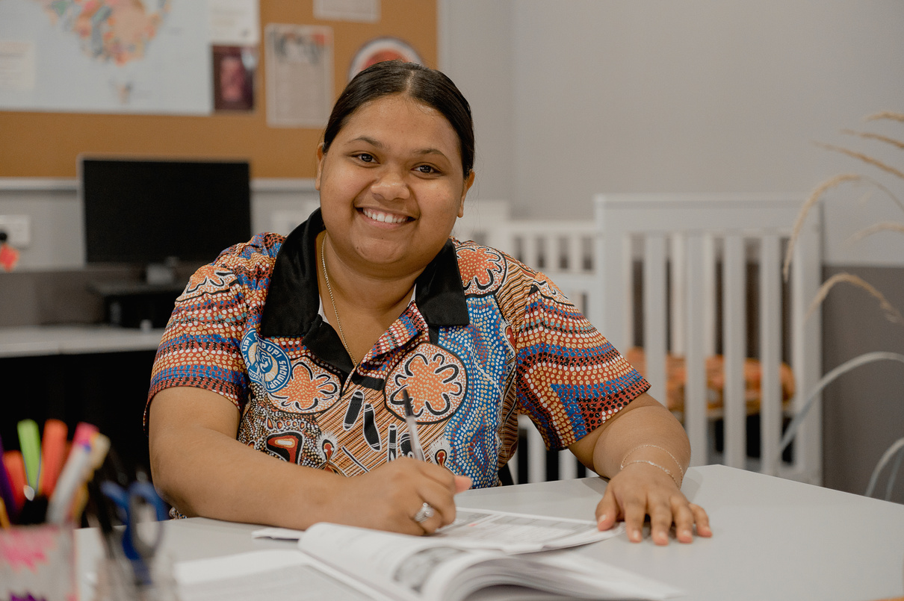
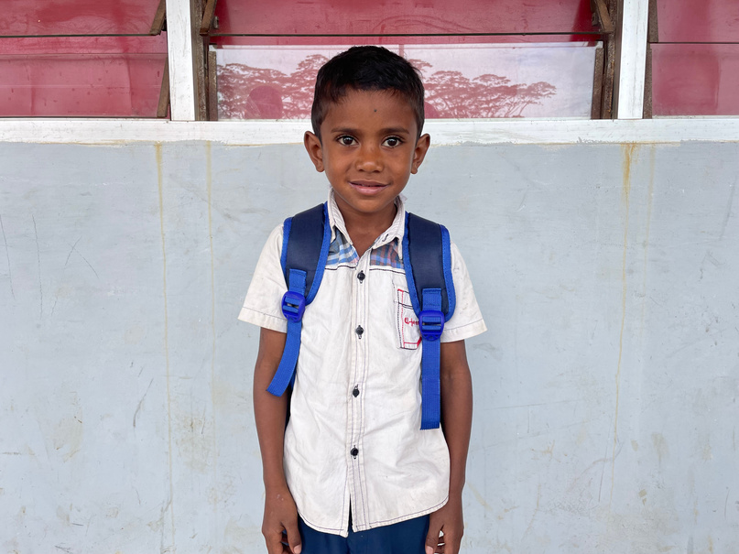
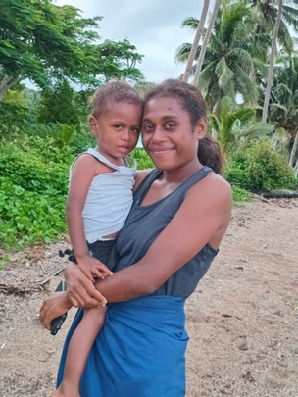
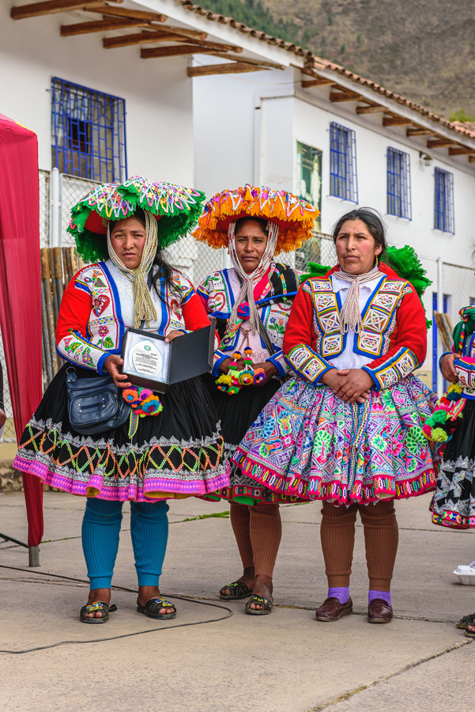
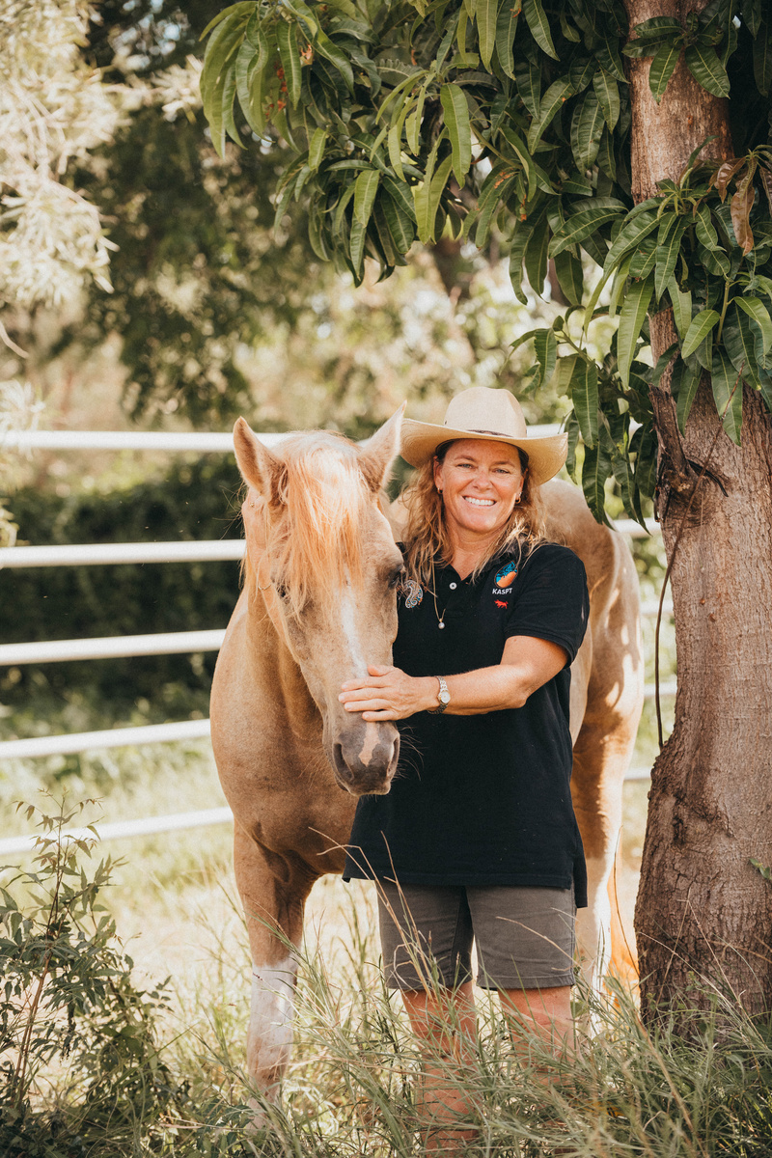
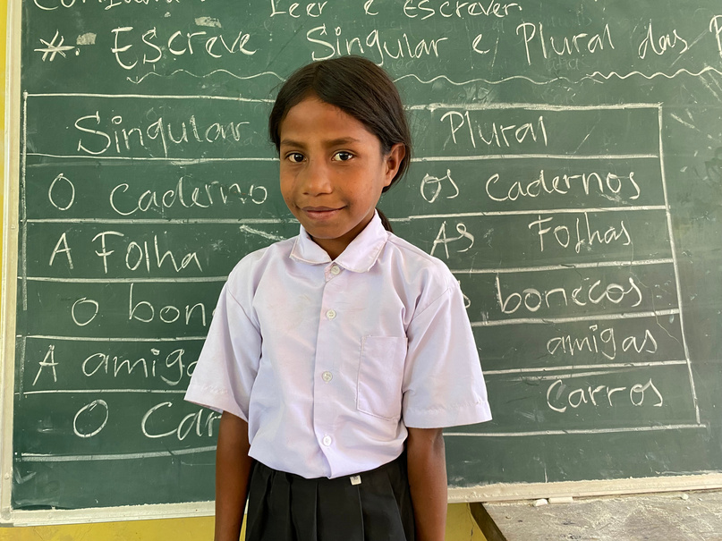
Who is Mary MacKillop Today?
Mary MacKillop Today is a not-for-profit organisation that continues the work of Mary MacKillop and the Sisters of St Joseph by delivering programs in Australia and overseas that focus on education, health, financial support and livelihoods.
Notes:
In the spirit of Saint Mary MacKillop, Mary MacKillop Today works to transform lives with dignity for self- determination.
Mary MacKillop fiercely believed in the power of education to lift communities out of poverty. She chose to teach everyone – regardless of gender, race, faith or wealth – while serving with love and compassion.
Mary MacKillop’s work is still unfinished. Many people are still unable to break the cycle of poverty because they can’t access education.
Mary MacKillop Today proudly continue her extraordinary 150-year-old legacy, so that all people have the opportunity to flourish.
6

Slide 7
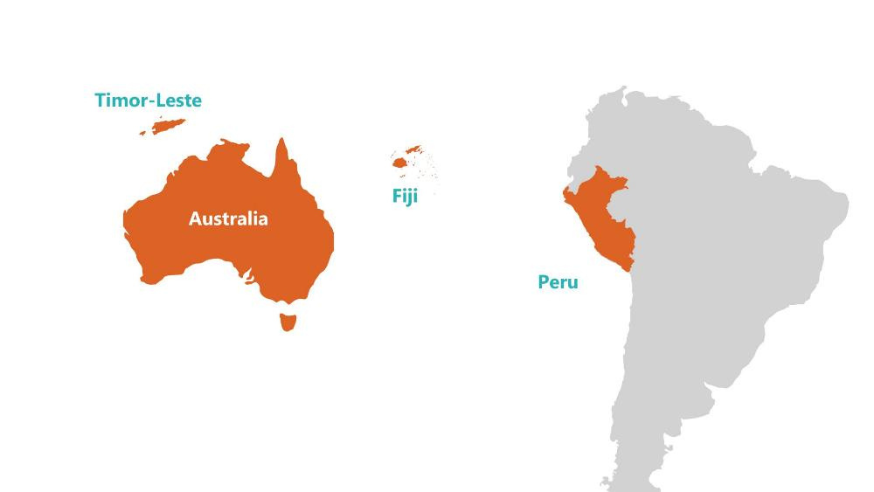
What does Mary MacKillop Today do?
  Works hard to ensure fair access to education.
  Working with communities to create change in Australia and overseas.
Notes:
Mary MacKillop Today works hard to ensure fair access to education for people to have the tools to realise their full potential.
This involves working with communities to create change by teaching practical skills to women, men and children in Australia, Timor-Leste, Fiji and Peru.
Since 1866, the Sisters of Saint Joseph have worked ‘for the flourishment of our earth and all its people’. Mary MacKillop Today continues that work to help people in the most vulnerable situations to flourish.
7

Slide 8

The need in Timor-Leste
  Many people in Timor-Leste live in poverty without access to education.
  Schools don’t have many resources.
  Many teachers have had limited education themselves, and some work as volunteers.
Notes:
Timor-Leste is a beautiful country and one of Australia’s closest neighbours. Sadly, 42% of the population live in poverty and access to education is very limited, particularly in rural and remote areas.
Schools don’t have many resources and about 35% of young people in rural areas cannot read and write.
Only 20% of children are enrolled in pre-school.
Many teachers have only had access to limited education themselves, so they are not able to provide a full education to the next generation. In some cases, they work as volunteer teachers.
Rural communities are often hard to get to with poor road conditions, so they are even more overlooked. Often, their families can’t afford to send their children to school – and even if they could, it would mean a long walk on dirt roads under the hot sun to get there.
The Sisters of St Joseph have been working in the communities in Timor-Leste for over 30 years and Mary MacKillop Today continues that work now.
8

Slide 9
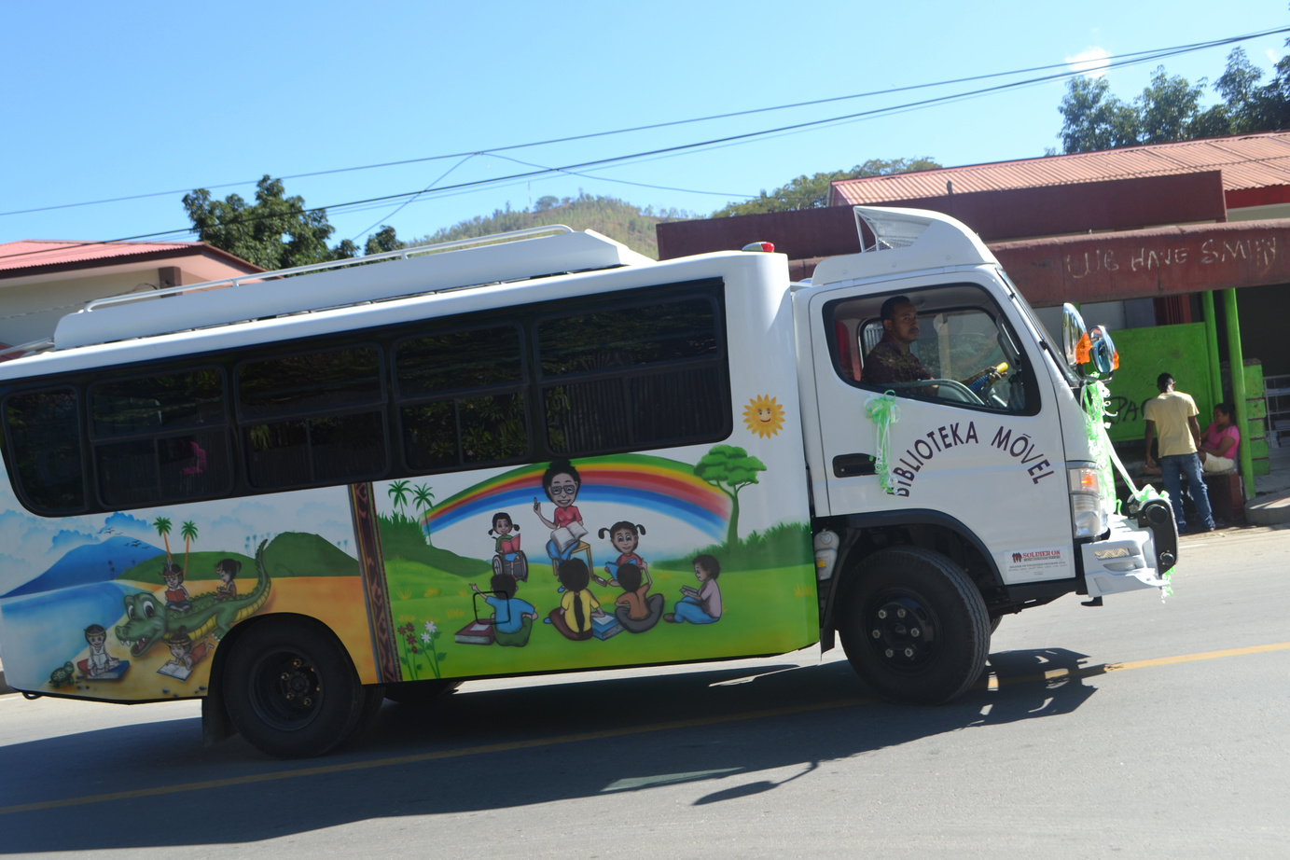
Mobile Learning Centre in Timor-Leste
  Colourful bus travels to some of the most remote areas of Timor-Leste.
  Provides access to books and educational materials.
  Helps teacher learn how to use different tools to teach.
Notes:
The Mobile Learning Centre gives children in Timor-Leste the opportunity to access books and educational materials through a library learning centre and interactive workshops.
The colourful bus travels to some of the most remote areas of Timor-Leste to visit schools bringing fun and creative tools to help children learn in their local language.
The project also helps to teach the teachers how to use different tools to teach in interactive and inclusive ways with books, puppets, arts and crafts and musical instruments.
Your support can help fund the running costs of our Mobile Learning Centre bus and outreach vehicles to reach the most remote areas and help provide fun learning resources, such as books, musical instruments, and arts and craft activities.
Each year, thousands of students across 25 schools experience the fun of the Mobile Learning Centre. Educational and musical resources are also distributed to even more schools throughout Timor-Leste.
9

Slide 10
This August, let’s follow the example of Australia's most loved saint and stand up to injustice when we see it.
Notes:
This August, let’s follow the example
Of Australia’s most loved saint
And stand up to injustice
When we see it.
10

Slide 11
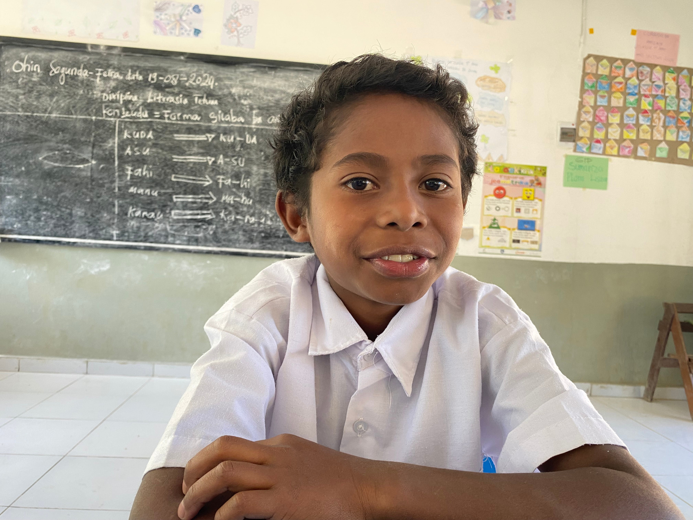
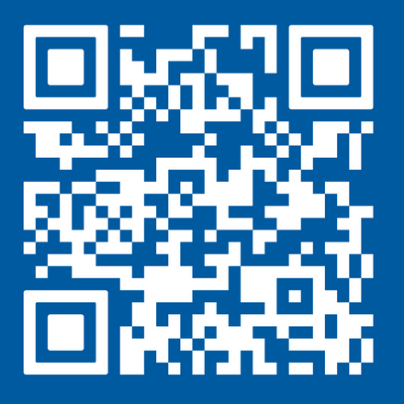
Thank you!
Find out more about the work of
Mary MacKillop Today at www.marymackilloptoday.org.au
Notes:
https://www.marymackilloptoday.org.au/mary-mackillop-feast-day/
11

